Slide 1
Php assignment
Half way assessment

Slide 2
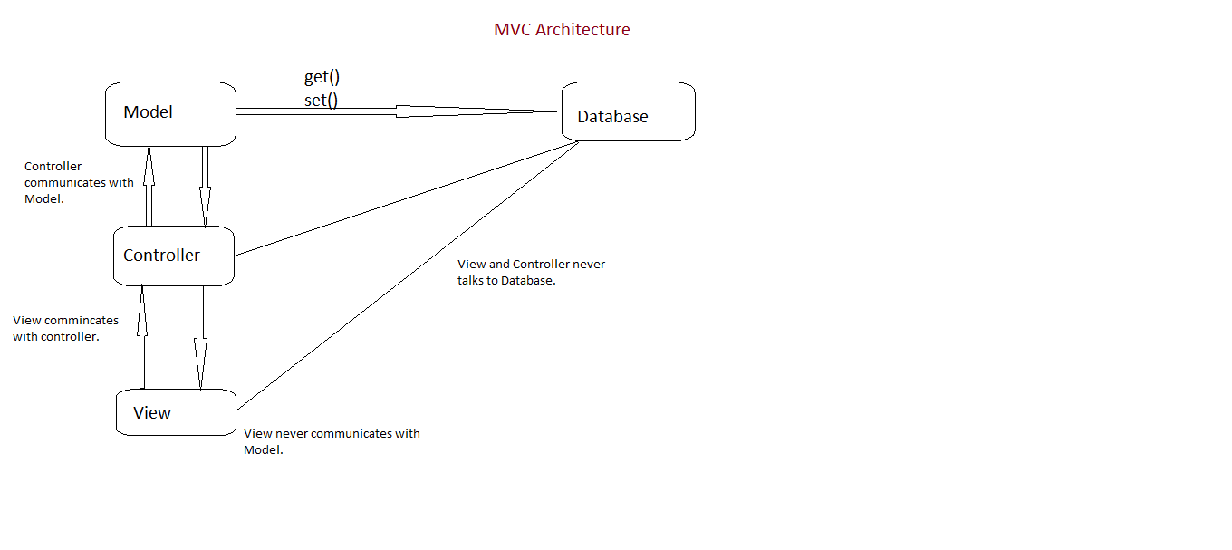
Architecture Design

Slide 3
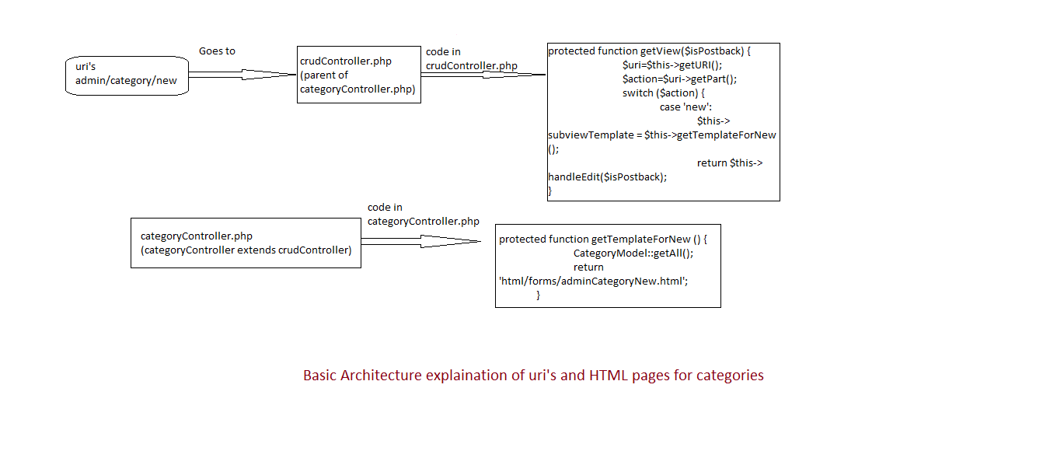

Slide 4
User stories
User A Computer Savvy
Goes on to website and in the search box enters Dell XPS
Finds what he wants clicks for more details
Views larger picture
Adds to the cart
Confirms quantity
He does not have an account
He creates an account

Slide 5
Enter his details into form
Choose a method type
Hits enter
He is congratulated and receives an email confirming purchase

Slide 6
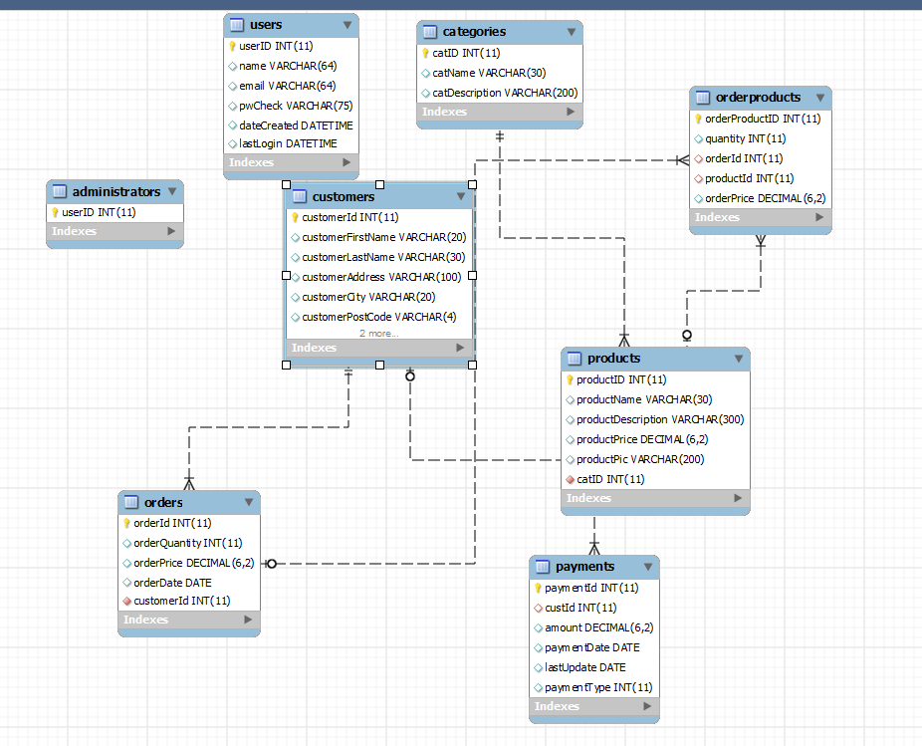
database

Slide 7
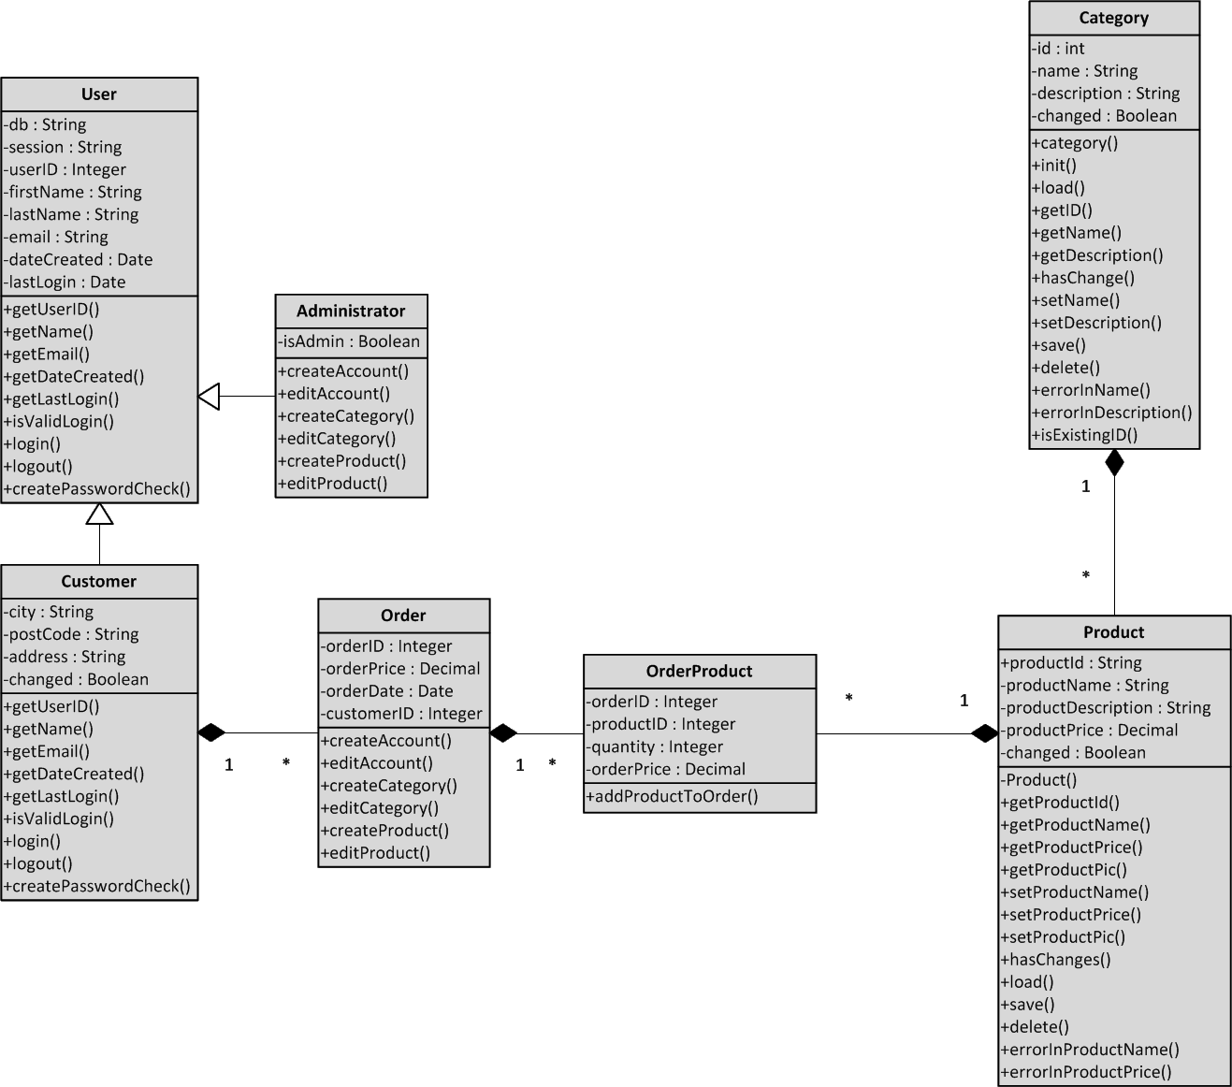
Class diagram

Slide 8
framework
The framework we are using is the one provided by Dr Mike Lopez and we have adapted it to develop our e-Commerce website.
It consists of series of models that are managed by controllers, they all either inherit from an abstract model and are embedded with defence mechanism against cross site scripting, sql injection and cross site request forgery which we will discuss in the next slides

Slide 9
What is SQL Injection?
What is SQL Injection? 11.SQL statements are inserted into an entry field for execution.
When SQL is used to display data on a web page, it is common to let users input their own values.
When input code on entry field, it dynamically change SQL statements to provide the user with selected data.
How to prevent SQL-injection in PHP?
In our code, we using
escape(),
throw new LoginException ('Invalid credentials');
try to call Common class “Abstract class”

Slide 10
Sql injection
Serious security Vulnerability
user can issue a SQL command to get access to back end database
This exposes the information- emails,user names,passwords etc..
This vulnerability accounts for over 83% of all attacks since 2005

Slide 11
SQL injection
original sql query:
SELECT * FROM table WHERE Username='username' AND Password='password';
With user input:
1)SELECT id FROM table WHERE Username=' ' OR ' ' =' ' AND Password=' 'password';
or
2) SELECT * FROM table WHERE Username='X' OR '1'='1';# 'AND Password='password';

Slide 12
SQL injection
Since the condition is true, hacker will be logged in to the system.
SQL prevention methods
1. Input validation
2. Limit database permission
3.Configure error reporting

Slide 13
SQL injection
1. Input validation
dictates what can or what can't be used in the input.
characters to watch for: ; '' ' /
for (int x=0;x<id.length;x++)
{
if(id.substring(0+x,1+x).equals(" ' " II '' ; '' II "/" II "#"))
{id="false";
}}

Slide 14
sql injection
2. Limit DB permission
Making the script read-only
3.Configure error reporting
It limits the amount of info the attacker receives from each attempt.
each error message-attacker gets closer to the data they want
so make the error message internal

Slide 15
sql injection
escape -function that checks if there are any quotation marks or harmful characters on text
it resets the harmful characters typed for username with a \ before those characters which makes the username and other fields incorrect to execute.

Slide 16
Cross site scripting xxs
Users are not to be trusted. Anyone who views the post will run the scritp
Document.cookie
Validate data

Slide 17
Differences betweens xxs and sql injection
SQL targets databases
XSS (javascript) targets other users

Slide 18
Plan for completion
As of 17/10/2014 we have not yet fully tested any of our models but we expect to have it completed for next presentation

Slide 19
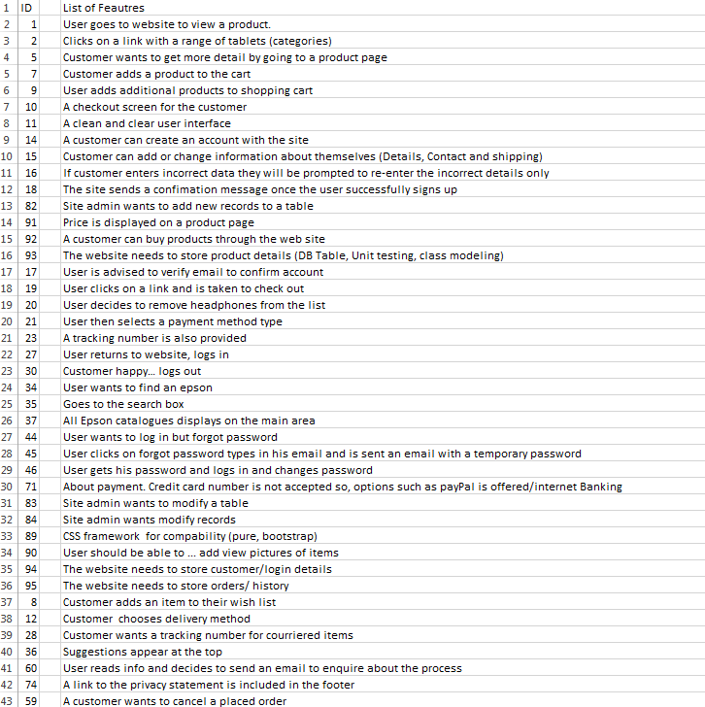

Slide 20
Proof of concept implementation
Cross site scripting Abstract Controller
protected function getInput($inputField) {
if (!isset($this->inputs[$inputField])) {
return null;
}
$input = trim($this->inputs[$inputField]);
return $this->sanitise($input);
}

Slide 21
private function sanitise($input) {
return htmlspecialchars($input, ENT_QUOTES);
}

Slide 22
Sql injection
Interfaces
function queryPrepared($parameterisedSQL,$fields);
function escape($fieldValue);
function executePrepared($parameterisedSQL,$fields);
}

Slide 23
public function escape($fieldValue) {
return $this->conn->real_escape_string($fieldValue); // TODO: charset
}public function queryPrepared($parameterisedSQL,$fields) {
throw new DatabaseException("Not yet implemented");
}
public function executePrepared($parameterisedSQL,$fields) {
throw new DatabaseException("Not yet implemented");
}
private function sqlError($source) {
return 'Unable to '.$source.', MySQL error ('.
$this->conn->connect_errno. ') is: '.
$this->conn->connect_error;
}

Slide 24
Cross site request forgery
Sends a request to the user that is passed onto a site that is believed to be logged into
Easiest form of protection is a Token Challenge system
At a token is generated on user log in
Can be done every time a form is loaded
When a form is submitted it has a hidden field containing the token
If the token checks out proceed as normal
Otherwise log the attempt and deny

Slide 25
